Slide 1

Data Engineering Class 2.2 Tuning a Regression & Building a Data Processing Pipeline
Carlos De Oliveira
(Carlos.DeOliveira@NYU.edu)
Fall 2023

Slide 2
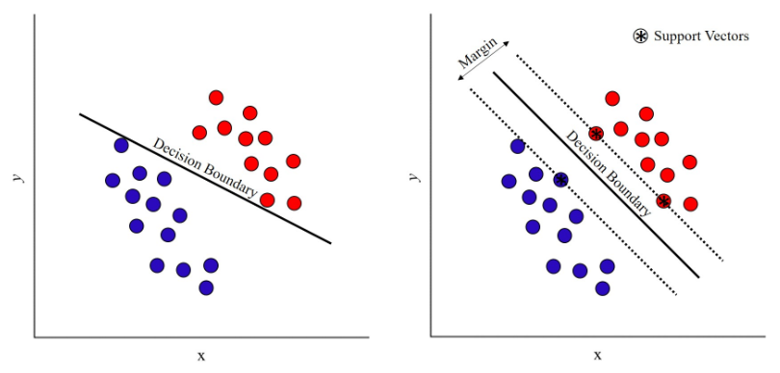
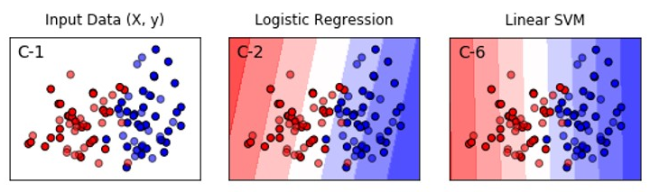
Support Vector Machine (SVM)
You should have PyCaret installed!!
Expands on the concept behind the log regression to create a classifier targeted directly at finding the maximum margin between classes

Slide 3
The kernel trick
A conventional SVM is a binary, linear classifier. Interestingly, it can be extended to non-linear classifications using the kernel trick.
The kernel trick utilizes all the SVM machinery we've introduced and substitutes a new non-linear mapping function into the definition of the hypothesis function.
The mathematical formulation is beyond the scope of this class, but you should know that the kernel trick exists and how to apply it to an SVC.
The most common kernel choice is a Gaussian Kernel.

Slide 4
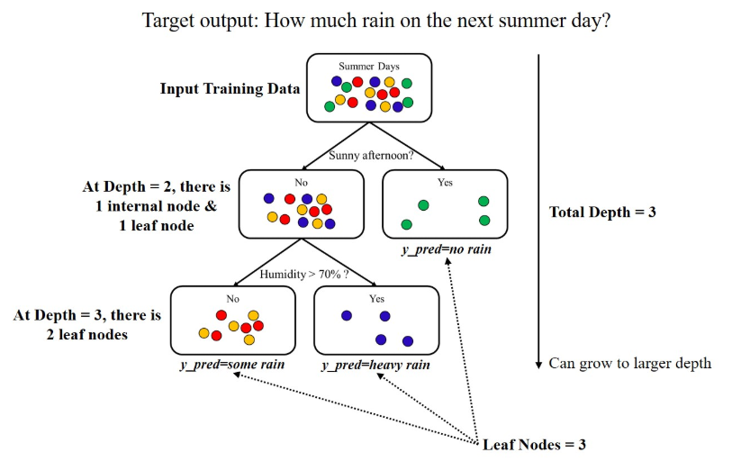
Decision Tree
The decision tree classifier will build a chain of logic very similar to how a human would make a decision.

Slide 5
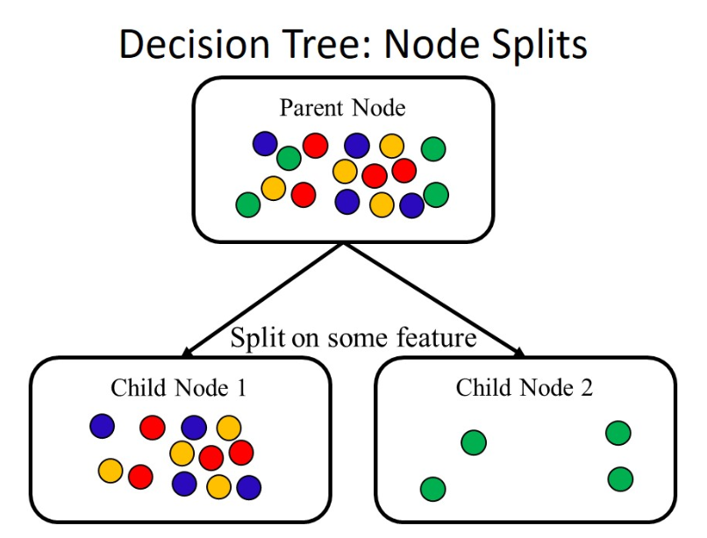
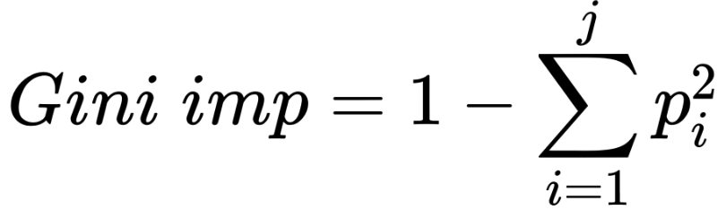
Impurity
sql DB for 6s / VOL- std (Max-Min)
The decision tree algorithm must learn where and how to split into nodes independently – it accomplishes this by simple relation based on impurity.
Translated to mathematics, impurity is how well the node would classify a randomly selected data point within it based on the distribution of its current contents – the lowest possible impurity is 0 and occurs when all the samples in a node are the same class (perfect leaf nodes).
For the location to split → solve the optimization problem:
The following diagram shows the child nodes for which
we want to minimize the sum of impurities
Scikit-learn uses Gini as its default measurement of impurity
If the list of i classes in the current node is [1, 2, 3,....., j] and the probability of picking the right class at random for an example data point in that node is p, then Gini is given by the following equation:

Slide 6
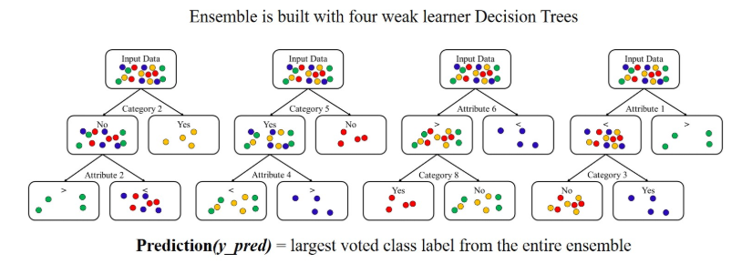
Random Forest
Random forest is an ensemble learning algorithm that is built with a series of constituent weak leaner trees, regularly extending into hundreds of learners.
The constituents then vote to form the prediction. The result is a method that generalizes well and often requires little (or no) tuning by the practitioner.

Slide 7
Tuning a prediction model
The goal of cross-validation is to reliably estimate generalizability, so you can tune confidently based on the estimations. The first step is adding a validation set to the training (X_train) and testingsets
The goal of cross-validation is to reliably estimate generalizability, so you can tune confidently based on the estimations. The first step is adding a validation set to the training (X_train) and testingsets
Tuning the parameters of the prediction model is vital for getting the best possible output
There are two types of parameters:
Internal parameters – tuned during the minimization of the loss function
Hyperparameters – constants added to the loss function or the minimization function that influences the tuning of the internal parameters
The goal of cross-validation is to reliably estimate generalizability, so you can tune confidently based on the estimations. The first step is adding a validation set to the training and testing sets

Slide 8
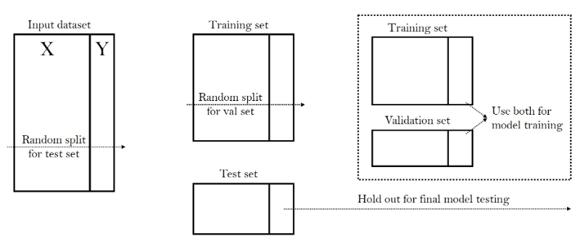
Cross-validation: Training, Validation and Test Sets
(see code example)

Slide 9
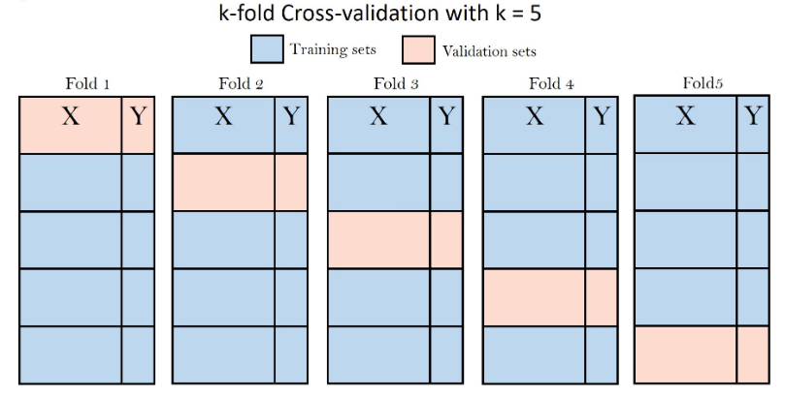
Multiple validation sets with k-fold method
The most common strategy for cross-validation is the k-fold method, which involves slicing the data into multiple folds and then cycling through them to make a train/validation set combination for each fold.
Then, if you are tuning knobs, you build a separate model on each fold and average the scores for each knob position.
(see code example)

Slide 10

Grid search for hyperparameter tuning
The act of hyperparameter tuning is typically referred to as knob tuning.
This is because it requires you to define a knob to turn and the position of the knob at you want to try.
Grid search is an optimization method for automating the hyperparameter tuning.
(see code example)

Slide 11

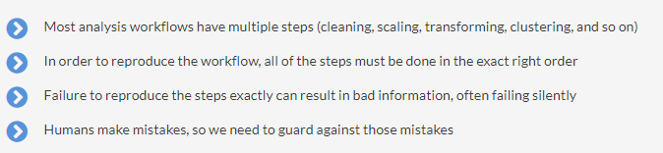
Pipelining the analysis
A pipelined analysis is a series of steps stored as a single function or object.
On top of providing a framework for your analysis, the most important reason for pipelining becomes apparent upon examining what is required to reproduce your workflow or apply it to new data.
(see code example)

Slide 12
Deploying the model
In a production environment, deployment is the step where you release your model into the wild and let it run on unforeseen data
Deployment produces many local analysis workflows that don't necessarily need to re-deploy, but do need to be stored and re-loaded later in order to reproduce the analysis
Both use cases require what is called model persistence, which means the model needs to be stored and loaded for later use
Storing an object requires a process called serialization to store in a reliable and error-free manner

Slide 13
Serializing and loading a serialized model
### Store Model for Later with Pickle ###
# import module
import pickle
# save the pipeline model to disk
pickle.dump(model, open('./model_storage/model.pkl', 'wb’))
# load the pipeline model from disk and deserialize
model_load = pickle.load(open('./model_storage/model.pkl', 'rb'))
# use the loaded pipeline model to predict on new data
y_pred = model_load.predict(X_test)

Slide 14
Python-specific deployment concerns
Python is not a compiled language. It is interpreted at the time of execution.
It is important to remember that, when you follow the steps, you are not pickling an executable program. You are simply pickling an object.
The pickled object is like a ZIP file in that anyone can bundle up anything inside it and you will not know it until you unpickle/unzip it.
Security should always be a concern with any file types that are not transparent.

Slide 15
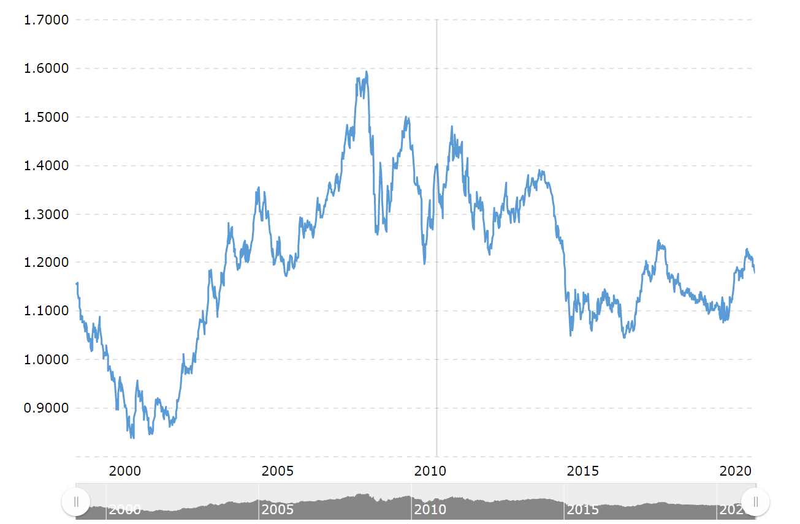
Past Final Presentation

Slide 16
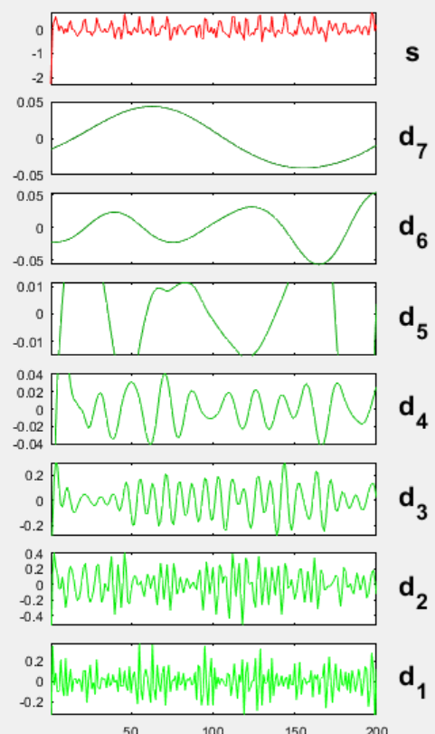
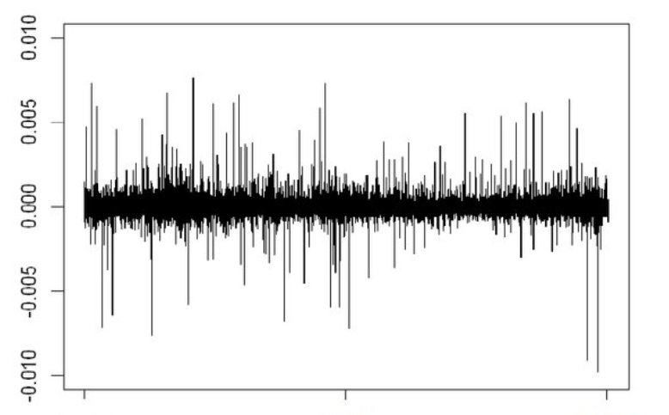
Wavelet decomposition of time-series

Slide 17
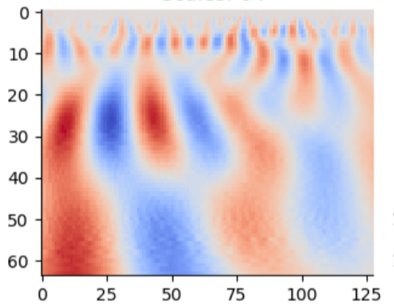
Wavelet decomposition of time-series

Slide 18

What you should do
Data analysis (missing, wrong, outliers, etc.)
Data compression (PCA, etc.)
Data clusters and phase diagram
Classification and/or estimation
Presentation → Class #7
Submit team material on NYU Classes
DB

Slide 19
Q&A
The floor is open to your questions

